Slide 1
Bootable USB – Surface Pro + Ubuntu 21.10
Ben Sottile

Slide 2
The Steps

Slide 3
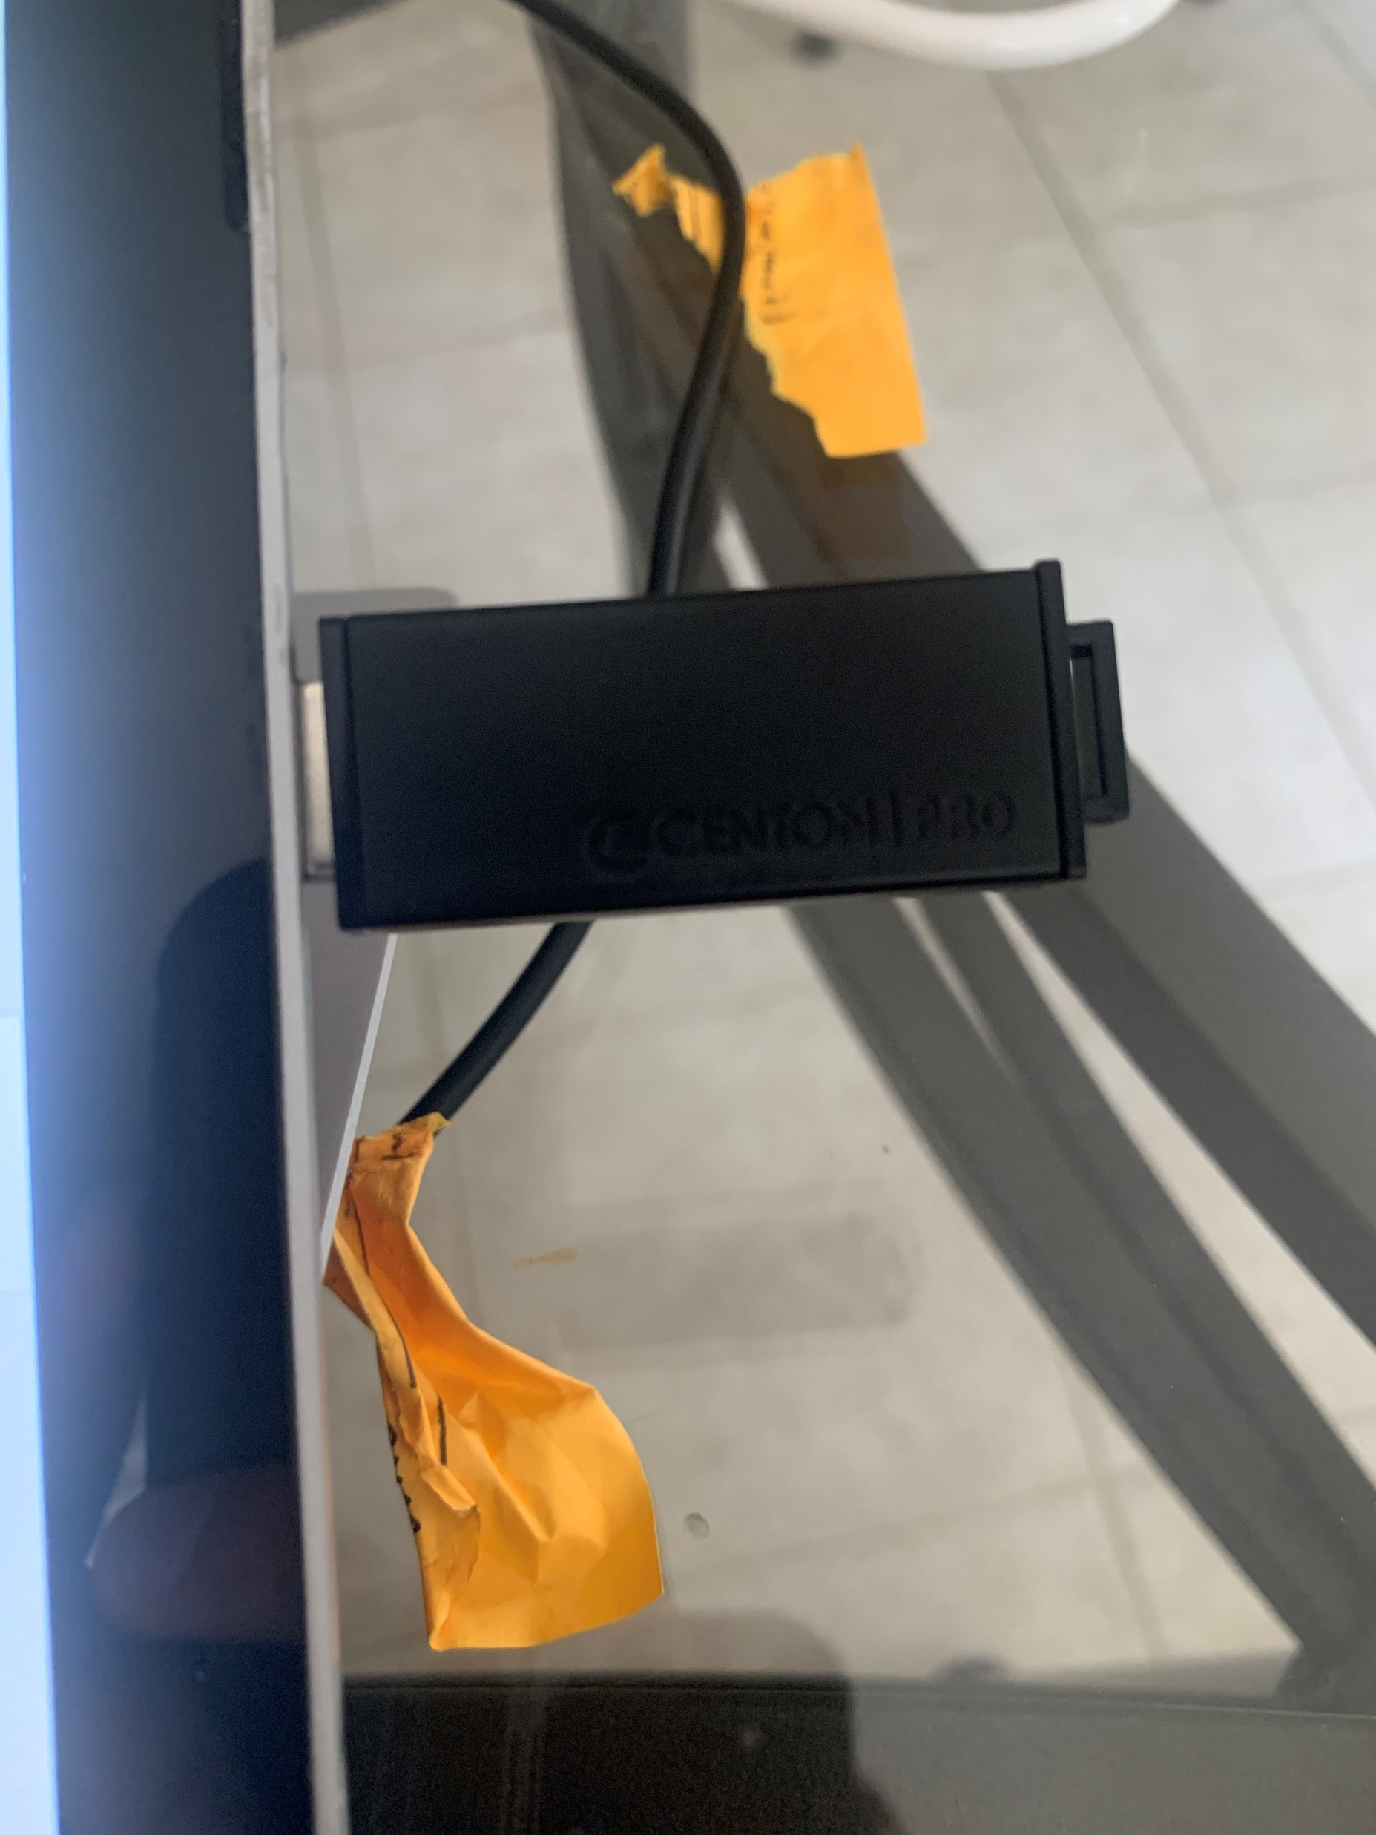
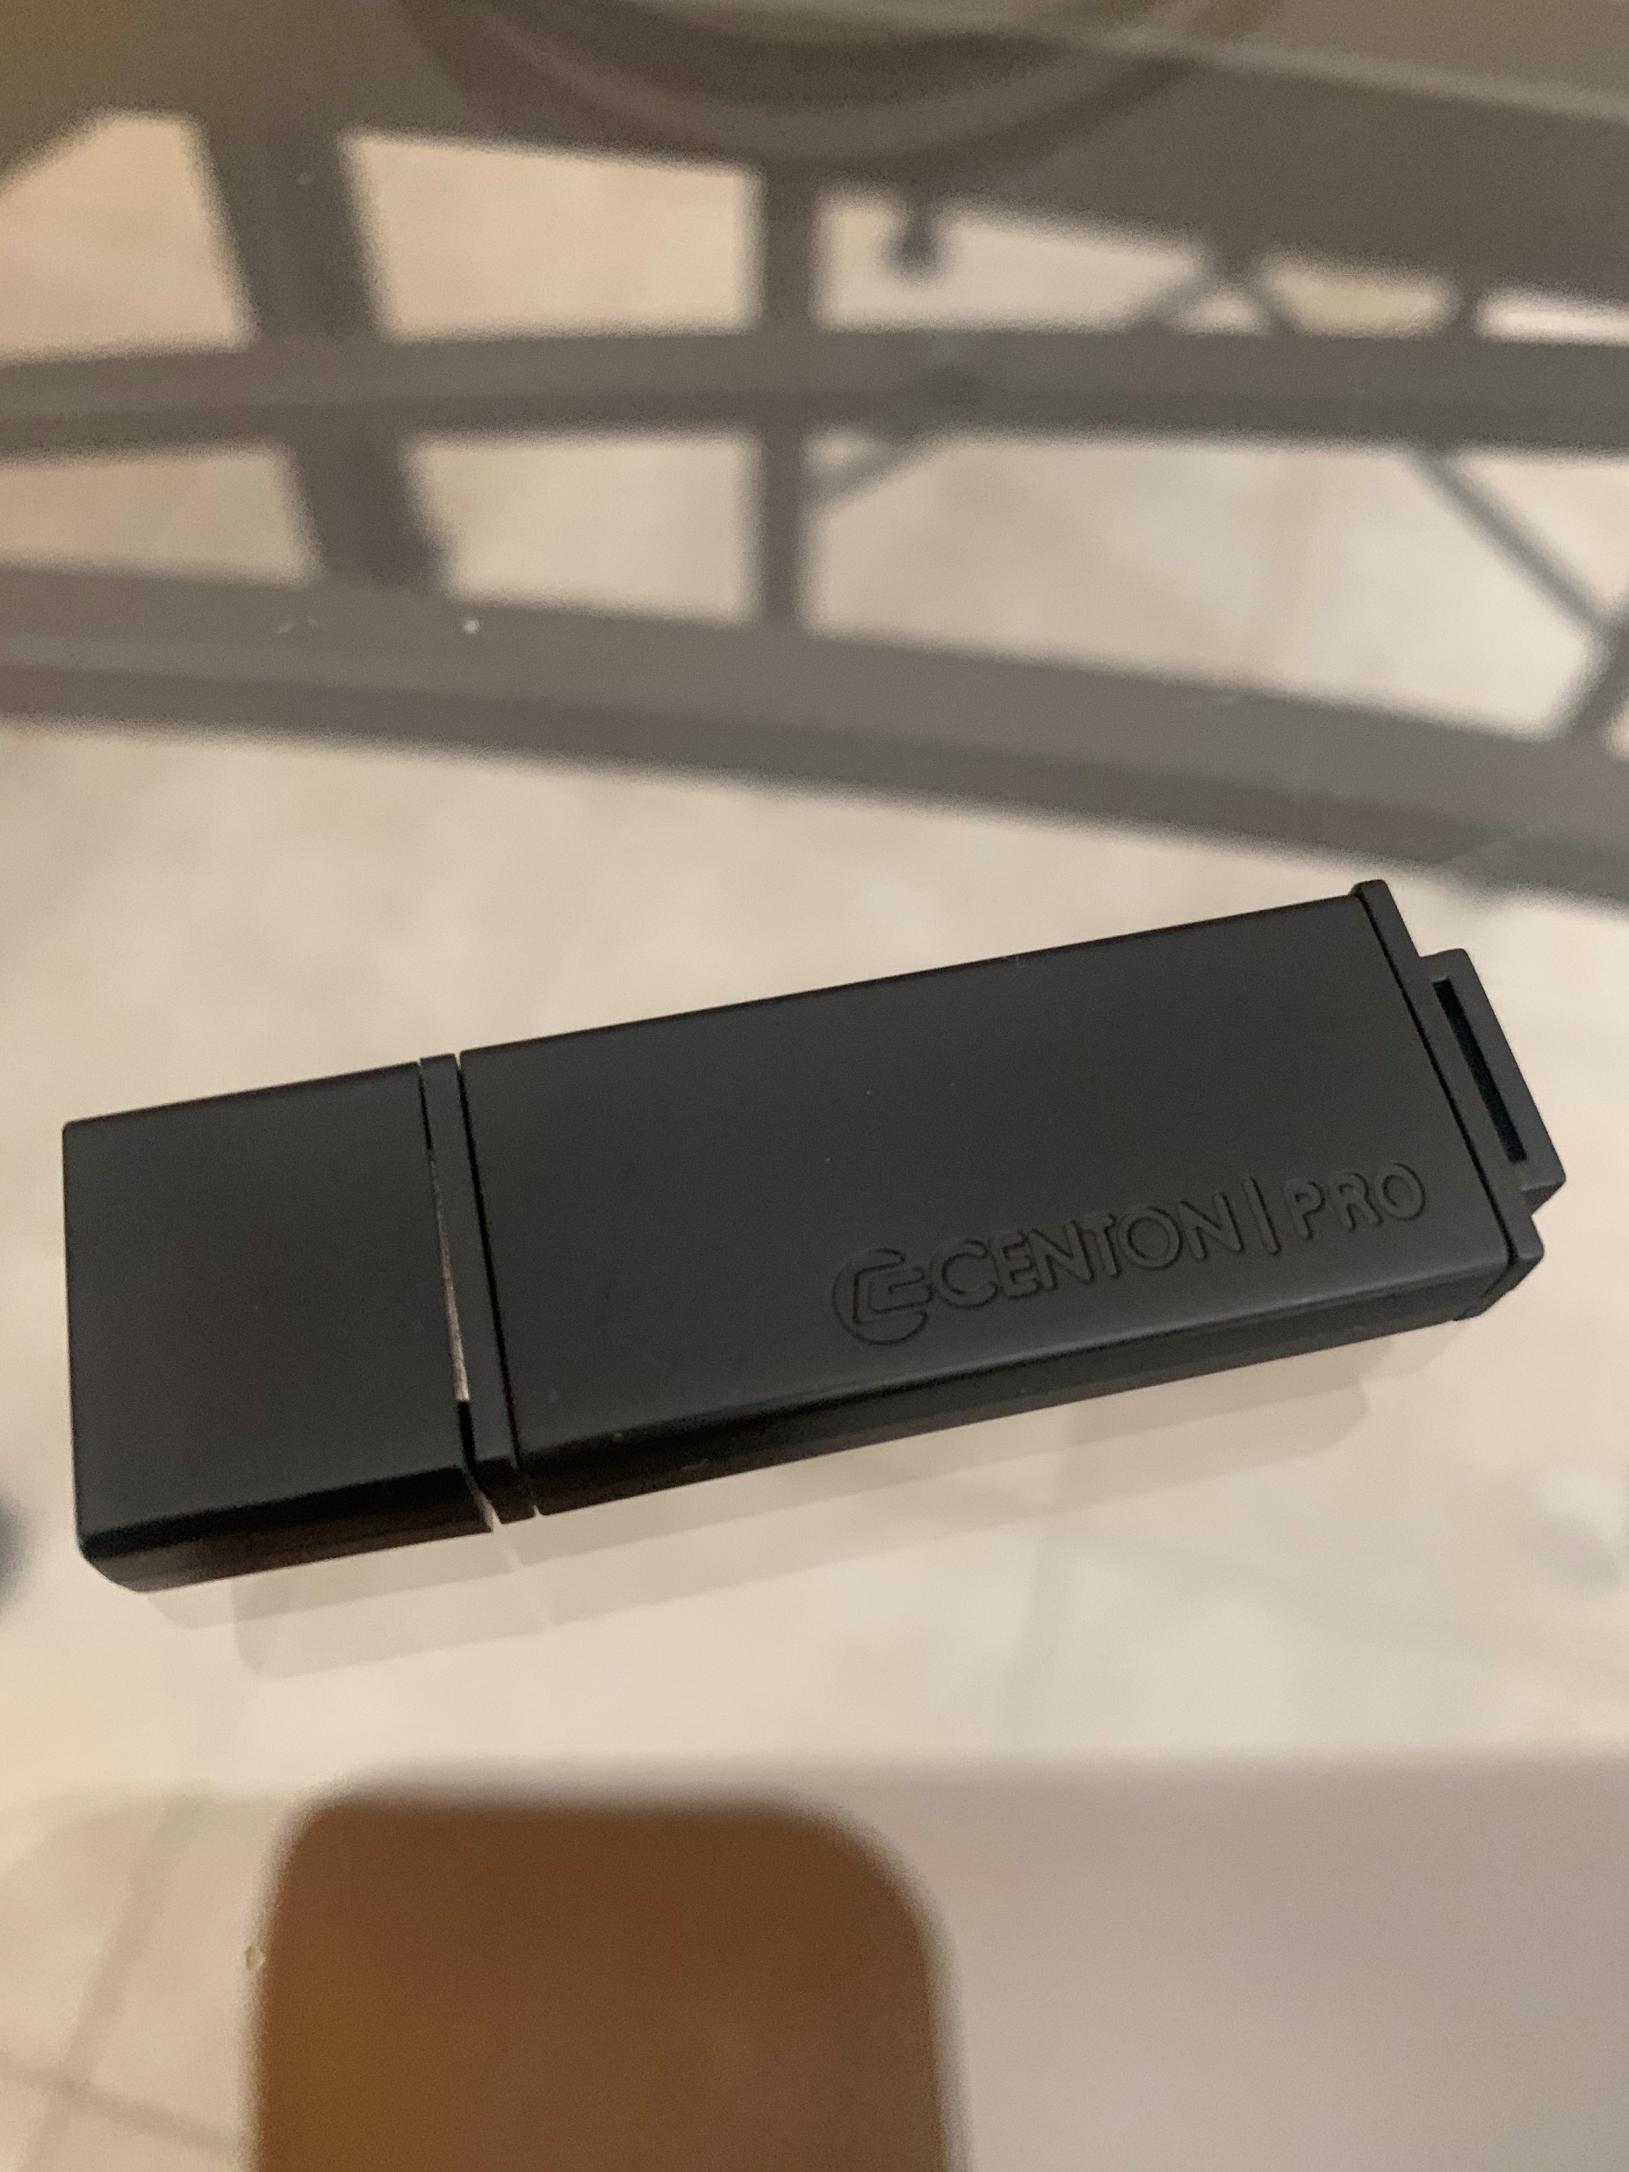
Bought a flash drive
a Centon Pro 32GB USB 3.0 Flash Drive-> $20(I got robbed!!!)

Slide 4
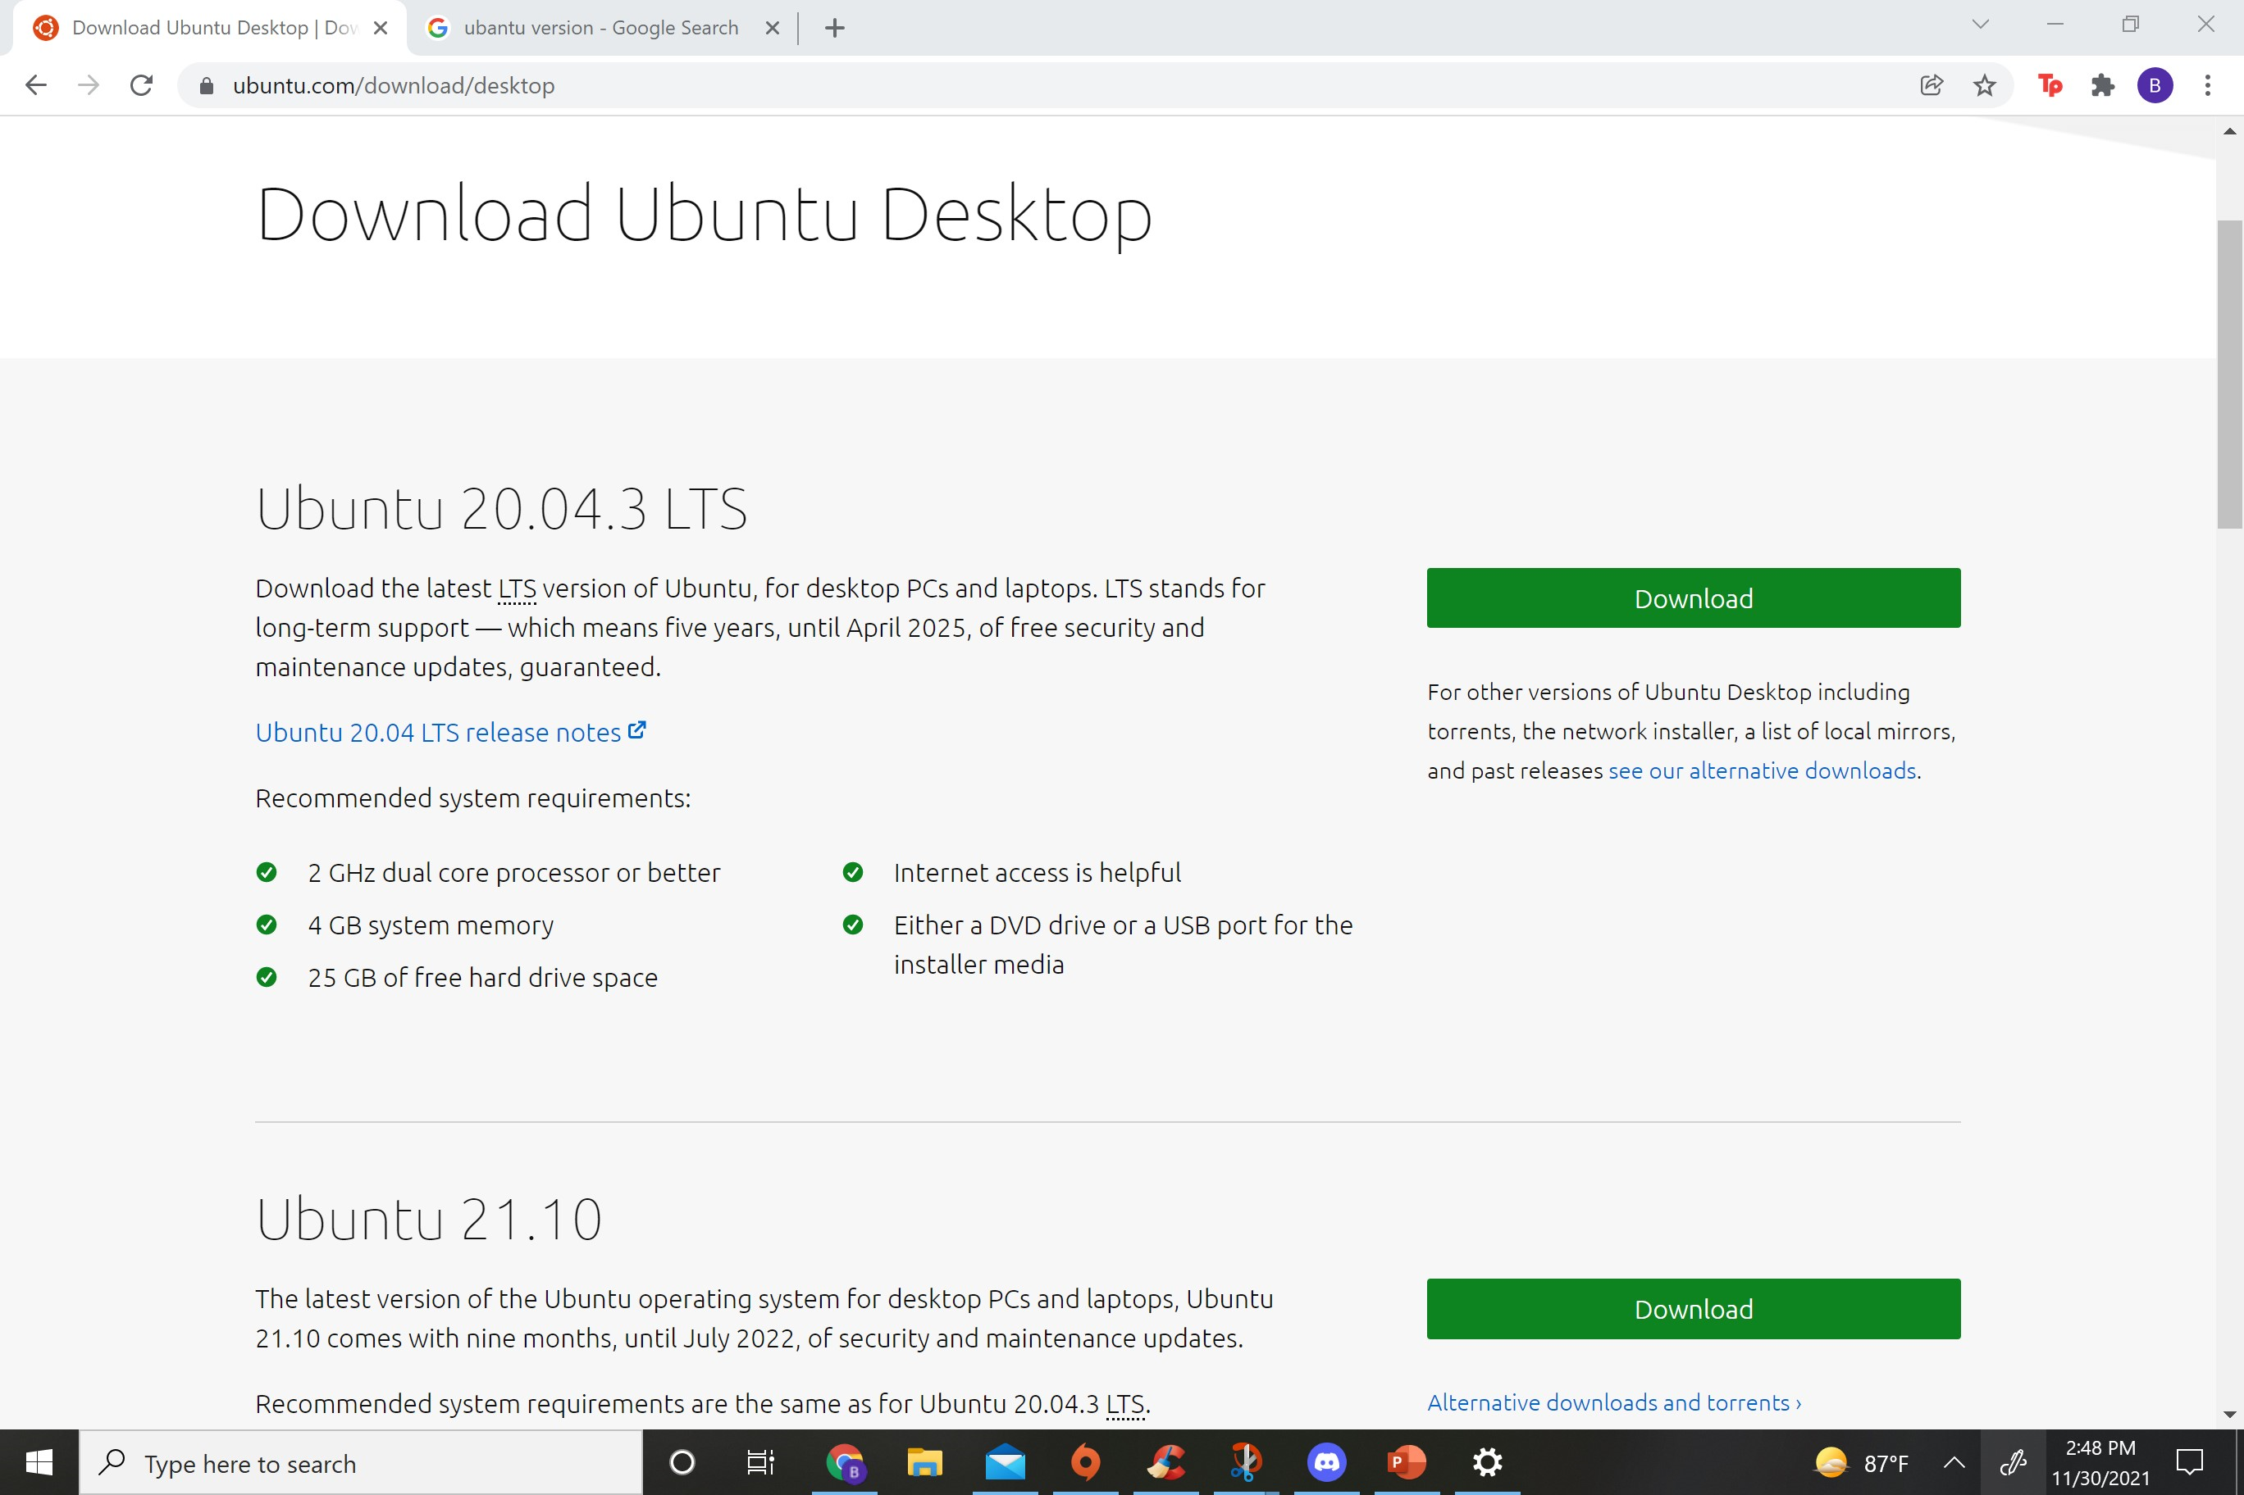
I downloaded the iso file(from Ubuntu.com)

Slide 5
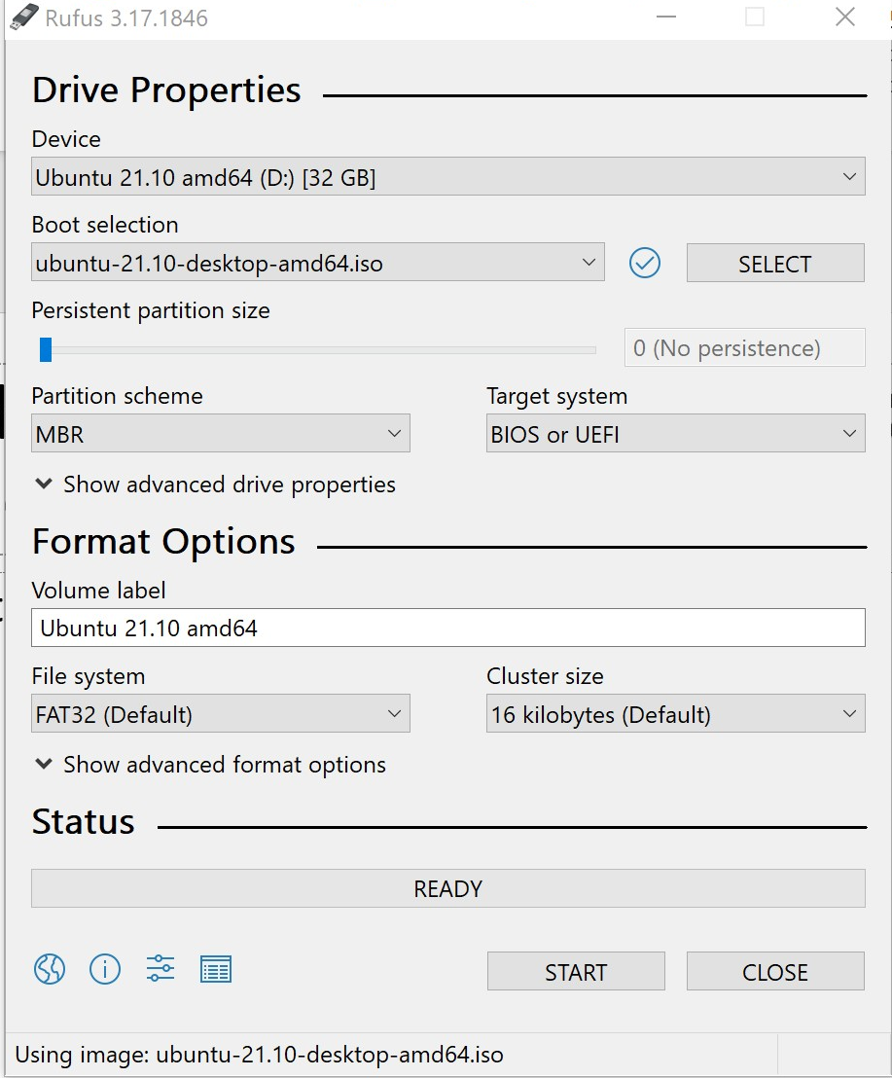
Used the open source program Rufus to write to the Flash drive

Slide 6

Demonstration

Slide 7
References
https://ubuntu.com/tutorials/create-a-usb-stick-on-windows#1-overview

